Slide 1
Natural language processing in Python using NLTK

Slide 2

Before we start Installation
To install this package with conda run:
conda install -c anaconda nltk
For central installation, set this to C:\nltk_data (Windows)

Slide 3
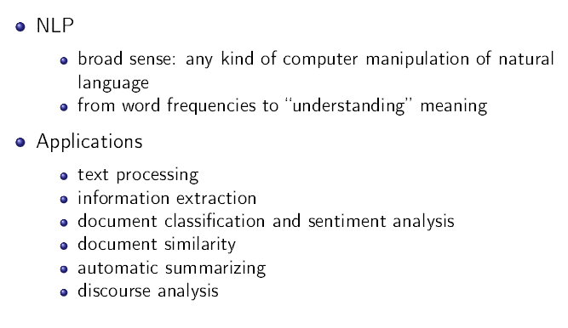
Natural language processing

Slide 4
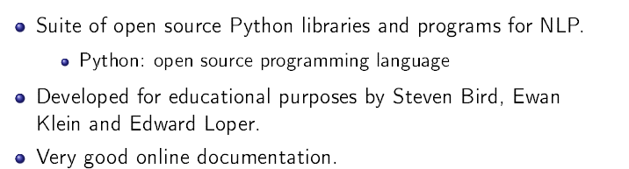
What is NLTK?
NLTK most widely used

Slide 5
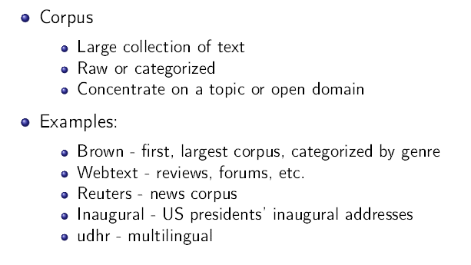
Text corpora

Slide 6
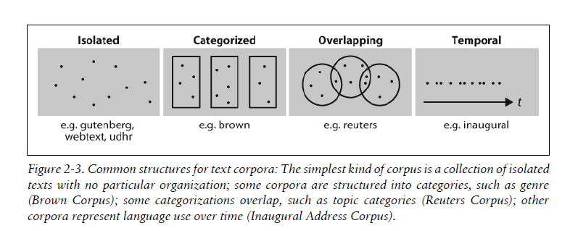
Common Structure of text corpora

Slide 7
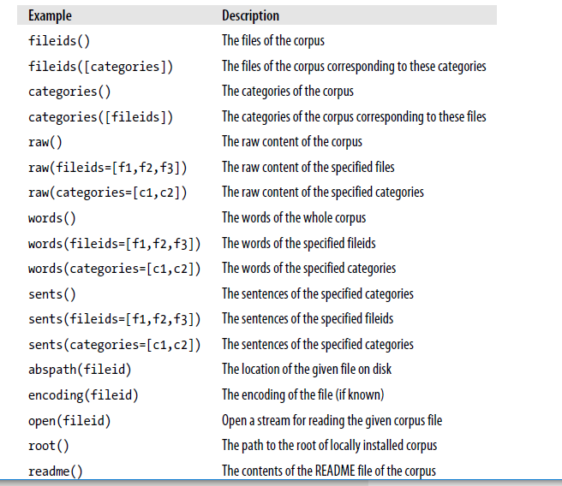
Basic corpus operations

Slide 8
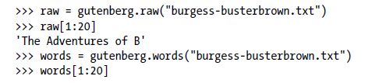
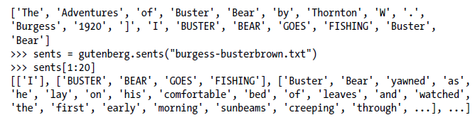
Basic corpus operations Cont.

Slide 9
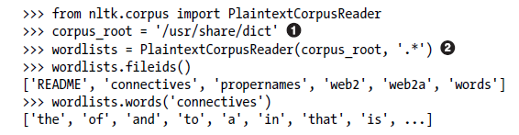
Loading Your Own Corpus

Slide 10
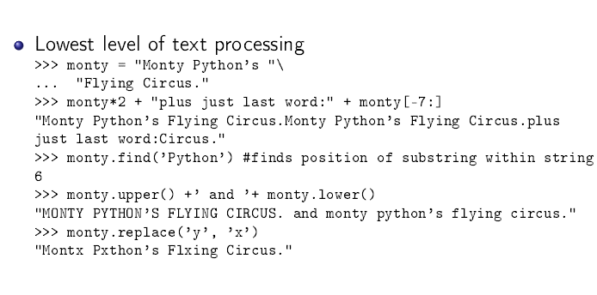
Strings: Text Processing at the Lowest Level

Slide 11
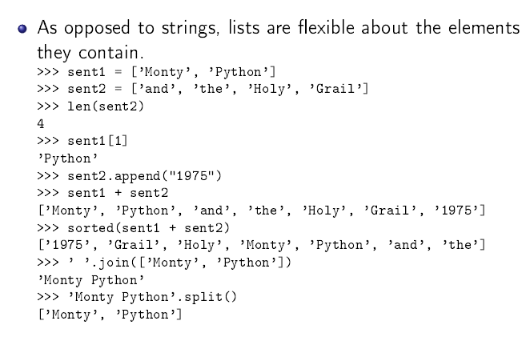
Texts as lists

Slide 12
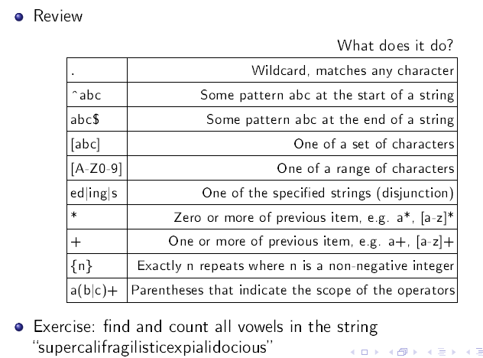
Regular expressions

Slide 13
Python RegEx
A RegEx, or Regular Expression, is a sequence of characters that forms a search pattern.
RegEx can be used to check if a string contains the specified search pattern.
import re txt = "supercalifragilisticexpialidocious" x = re.findall(“[aeoiu]", txt)

Slide 14
Tokenization, normalization
The raw content of the text, including many details we are not interested in, such as whitespace, line breaks, and blank lines.
break up the string into words and punctuation
Tokenize raw text - divide into tokens.
tokens = nltk.word_tokenize(raw)
tokens[:10]
Normalize tokens - remove upper case and capital letter.
set(w.lower() for w in tokens)
Notes:
Tokenization is the task of cutting a string into identifiable linguistic units that constitute
a piece of language data

Slide 15

Regular Expressions for Tokenizing Text
Tokenization is the task of cutting a string into identifiable linguistic units that constitute a piece of language data
The very simplest method for tokenizing text is to split on whitespace

Slide 16
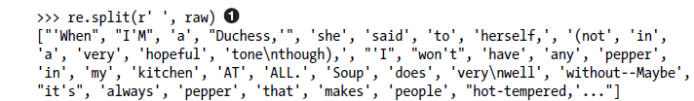
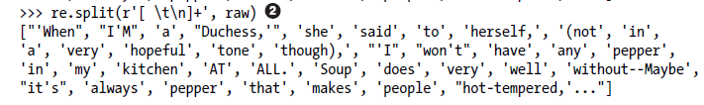
Simple Approaches to Tokenization
it is not enough to match any space characters in the string , since this results in tokens that contain a \n newline character; instead, we need to match any number of spaces, tabs, or newlines :

Slide 17
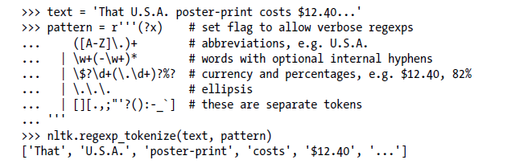
NLTK’s Regular Expression Tokenizer
The function nltk.regexp_tokenize() is similar to re.findall()

Slide 18
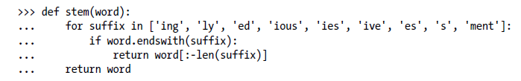
Finding Word Stems
A query for laptops finds documents containing laptop and vice versa. Indeed, laptop and laptops are just two forms of the same dictionary word (or lemma)

Slide 19
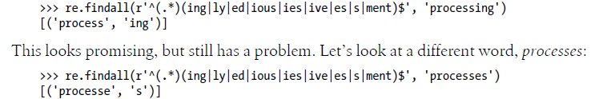
use regular expressions for this task
Here, re.findall() just gave us the suffix even though the regular
expression matched the entire word. This is because the parentheses
have a second function, to select substrings to be extracted.

Slide 20
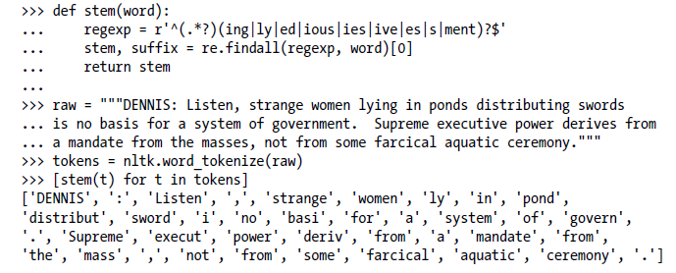
Use regular expressions for this task Cont.

Slide 21
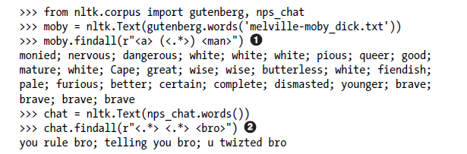
Searching Tokenized Text
include <.*> , which will match any single token, and enclose it in parentheses so only the matched word (e.g., monied) and not the matched phrase (e.g., a monied man) is produced. The second example finds three-word phrases ending with the word bro

Slide 22
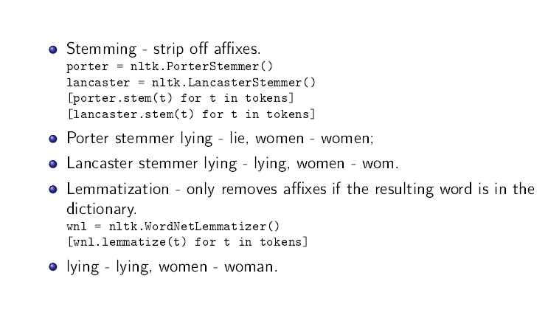
Stemming and lemmatization
A further step is to make sure that the resulting form is a known word in a
dictionary

Slide 23
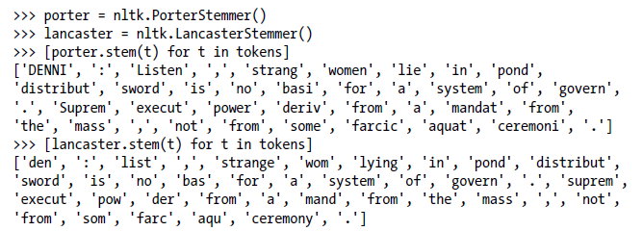
Stemming in NLTK
Stemming is not a well-defined process, and we typically pick the stemmer that best suits the application we have in mind. The Porter Stemmer is a good choice if you are indexing some texts and want to support search using alternative forms of words

Slide 24
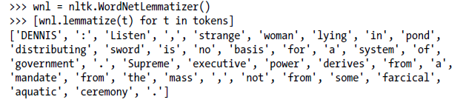
Lemmatization
The WordNet lemmatizer removes affixes only if the resulting word is in its dictionary.
This additional checking process makes the lemmatizer slower than the stemmers just mentioned. Notice that it doesn’t handle lying, but it converts women to woman.
The WordNet lemmatizer is a good choice if you want to compile the vocabulary of some texts and want a list of valid lemmas

Slide 25
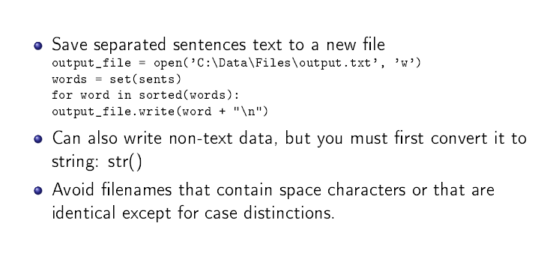
Writing output to file

Slide 26

Reading Local Files

Slide 27
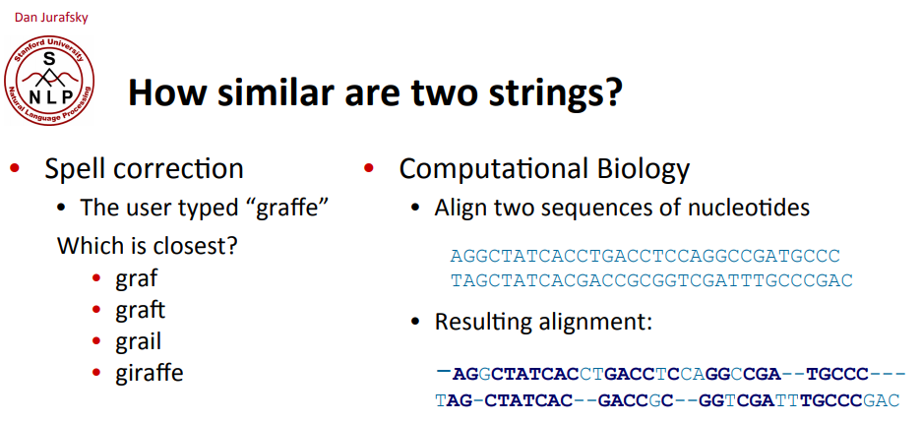
Minimum Edit Distance

Slide 28
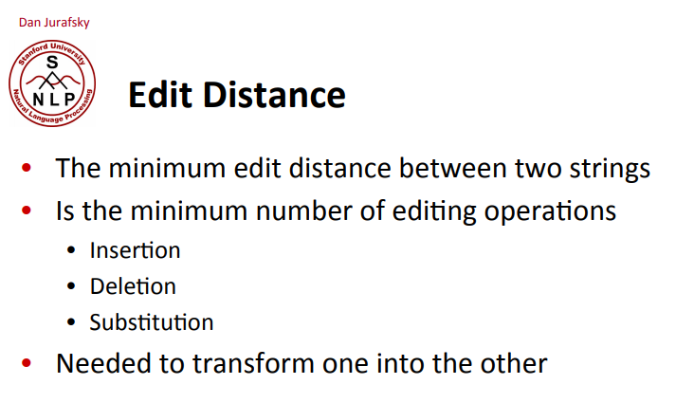
Minimum Edit Distance

Slide 29
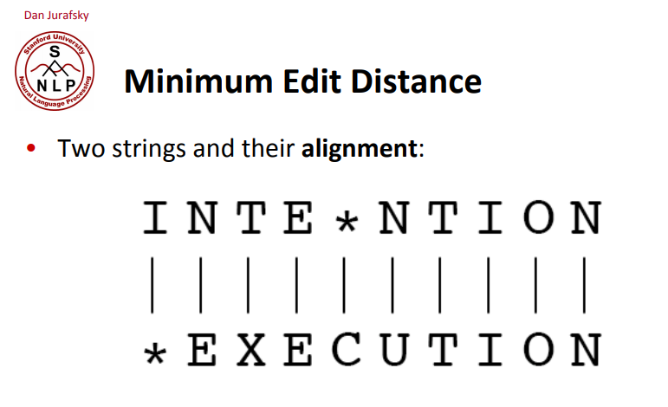
Minimum Edit Distance

Slide 30
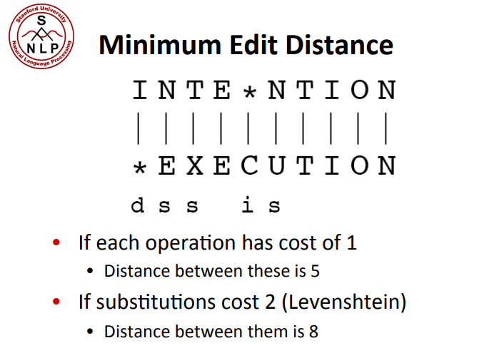
Minimum Edit Distance

Slide 31
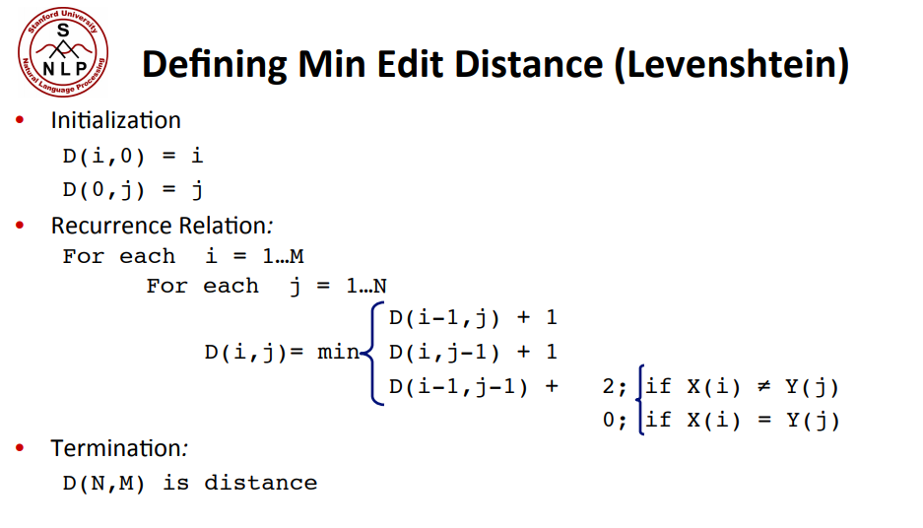
Minimum Edit Distance

